Slide 1
Meteo brífing
Ne 20.06.2021
Ing. Ivan Chlebovec

Slide 2
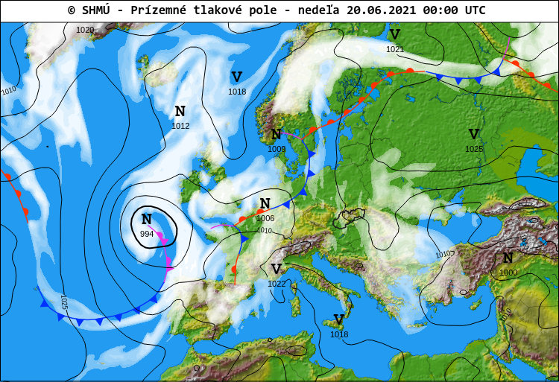

Slide 3
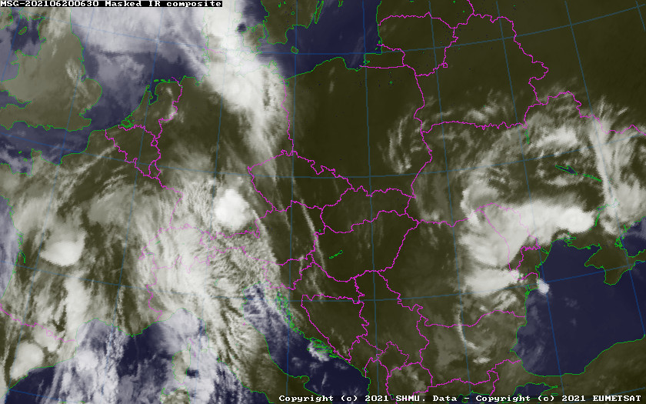

Slide 6
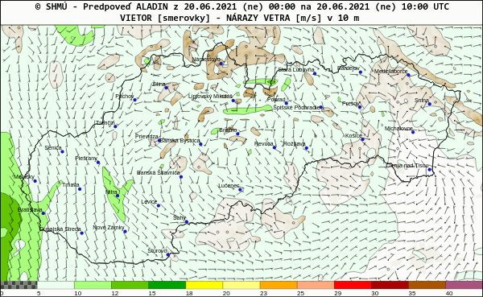
LZNI: 130°05 m/s

Slide 7
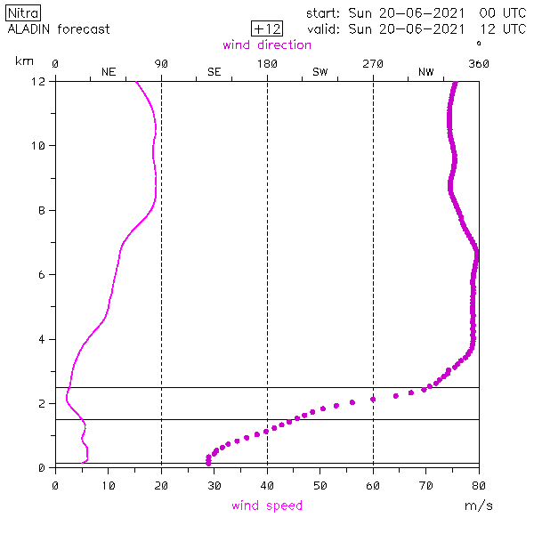
wind direction
Wind profile,
14:00 LT for Nitra
height [km]
wind speed

Slide 8
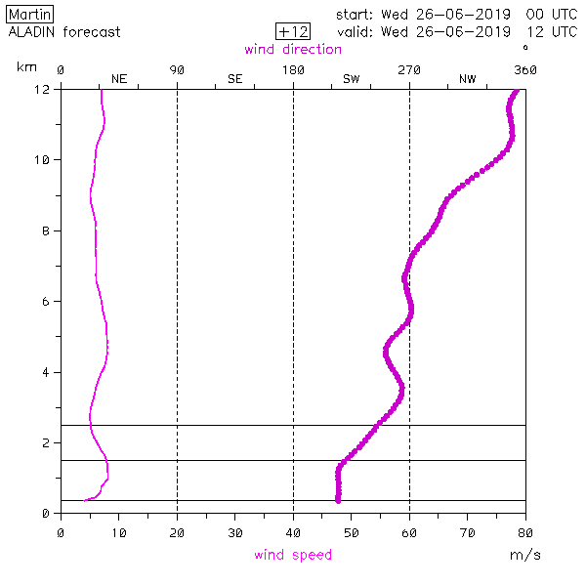
wind direction
Wind profile,
14:00 LT for Nitra
@3000m 250°05m/s
@2000m 230°06m/s
@1500m 220°07m/s @1000m 210°07m/s
height [km]
wind speed

Slide 9
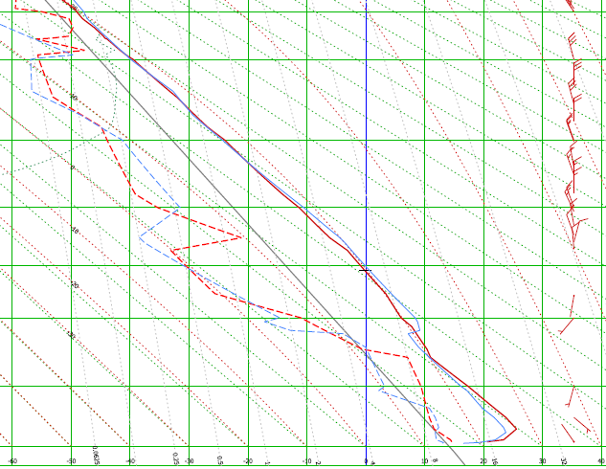
Prostějov
- aerological sounding
7200m
5500m
4200m
3000m
Legend:
red = today
blue = yesterday
solid line = temperature
dashed line = dew point
1500m
100m

Slide 10
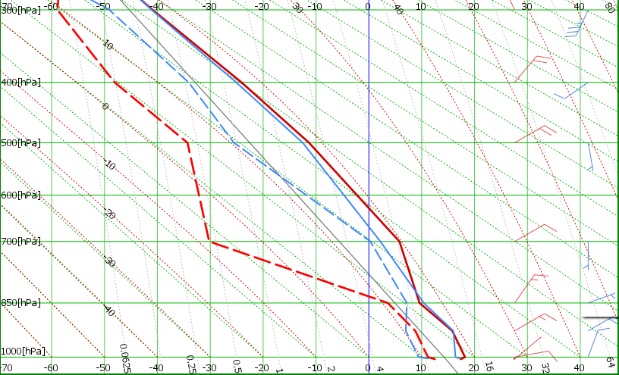
Brest
aerological sounding
7200m
5500m
4200m
3000m
Legend:
red = today
blue = yesterday
solid line = temperature
dashed line = dew point
1500m
100m

Slide 11
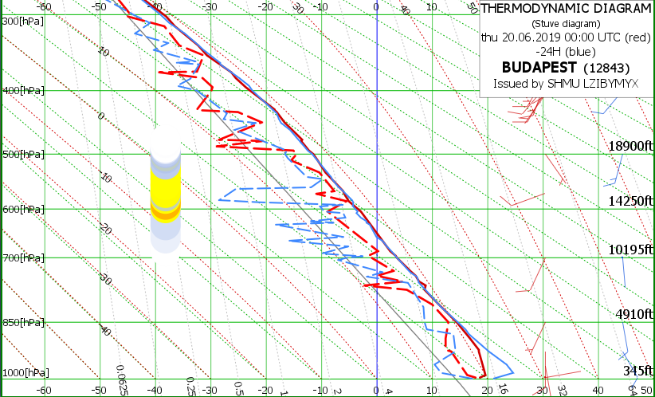
Prostějov
- aerological sounding
7200m
5500m
4200m
3000m
Legend:
red = today
blue = yesterday
solid line = temperature
dashed line = dew point
1500m
100m

Slide 12
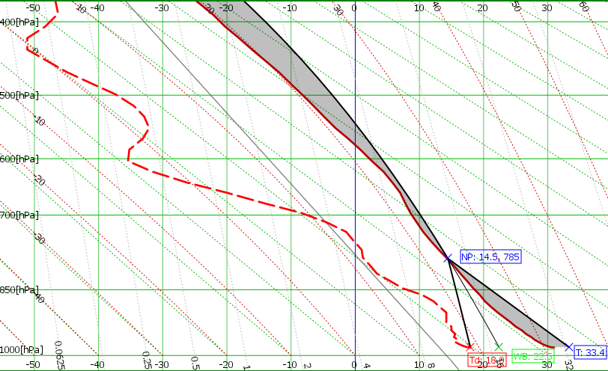
Martin, 12:00 UTC
- pseudotemp Aladin_sk
Tmax = 34°C
Tc = 27°C
climbs ~ m/s
Cu @ 2400m MSL
Thermals till 17:00 LT
5500m
4200m
3000m
1500m
100m

Slide 13
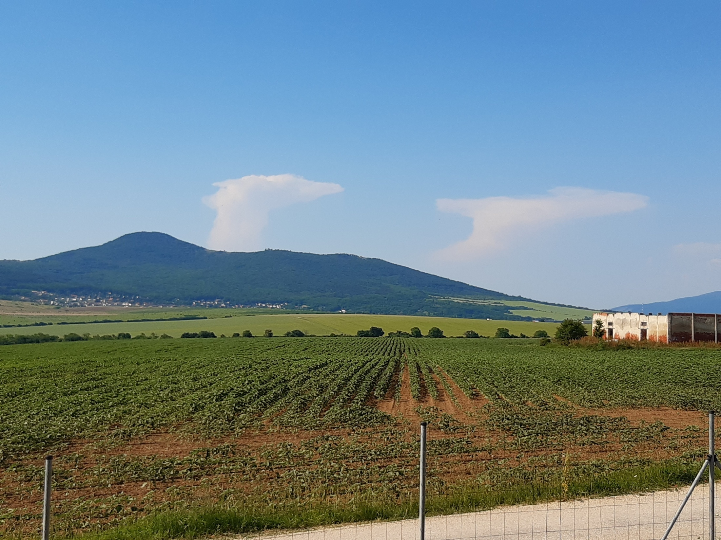
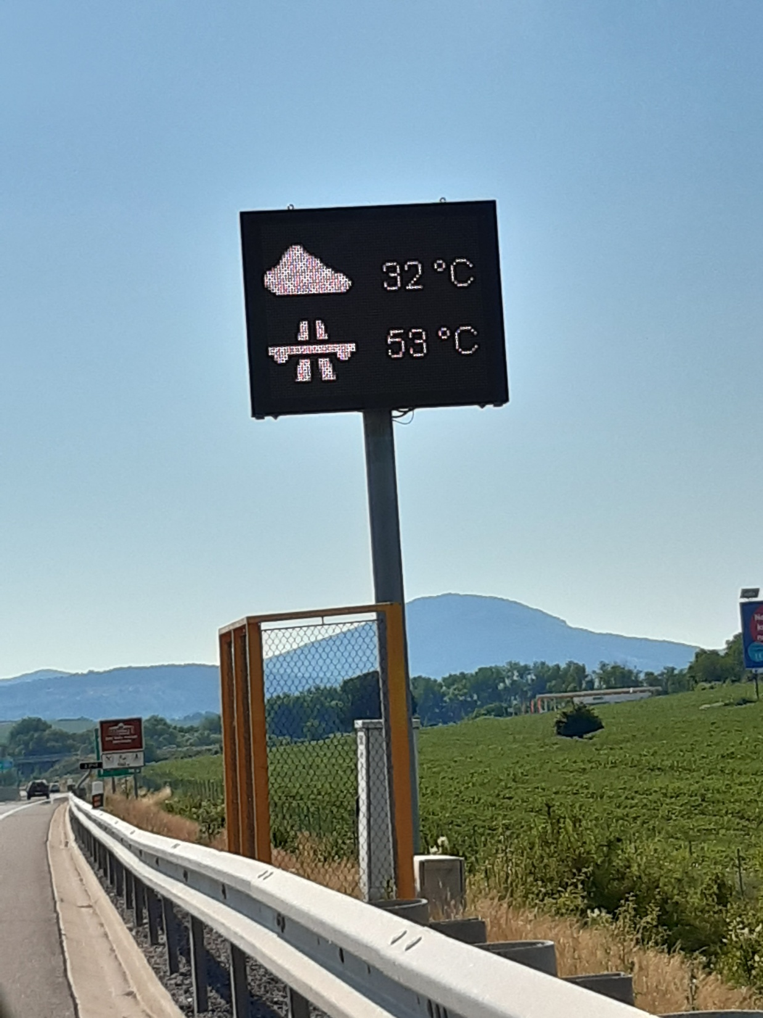
včera:

Slide 14
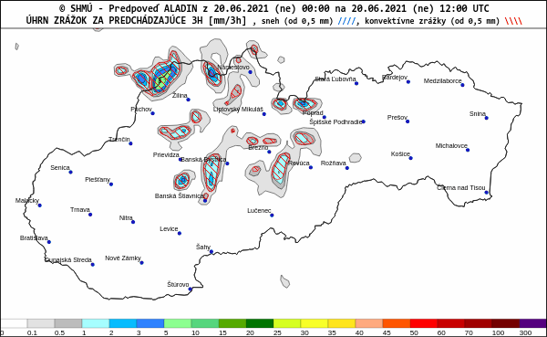
Tmax = 34°C
Cu @ 2000m MSL

Slide 15
Martin, 12:00 UTC
- pseudotemp Aladin_sk
Tmax = 34°C
Tc = 27°C
climbs ~ m/s
Cu @ 2400m MSL
Thermals till 17:00 LT
5500m
4200m
3000m
1500m
100m

Slide 16
Martin, 12:00 UTC
- pseudotemp Aladin_sk
Tmax = 34°C
Tc = 27°C
climbs ~ m/s
Cu @ 2400m MSL
Thermals till 17:00 LT
5500m
4200m
3000m
1500m
100m

Slide 17
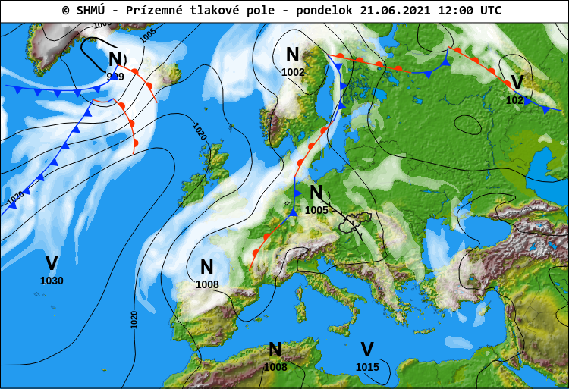
Zajtra...

Slide 18
Zajtra...

Slide 19
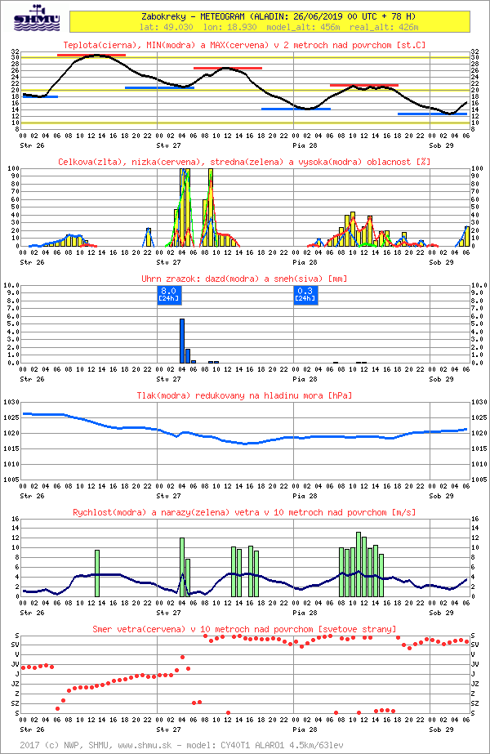
temperature
clouds
rainfall

Slide 20
air pressure
wind speed
wind direction

Slide 21
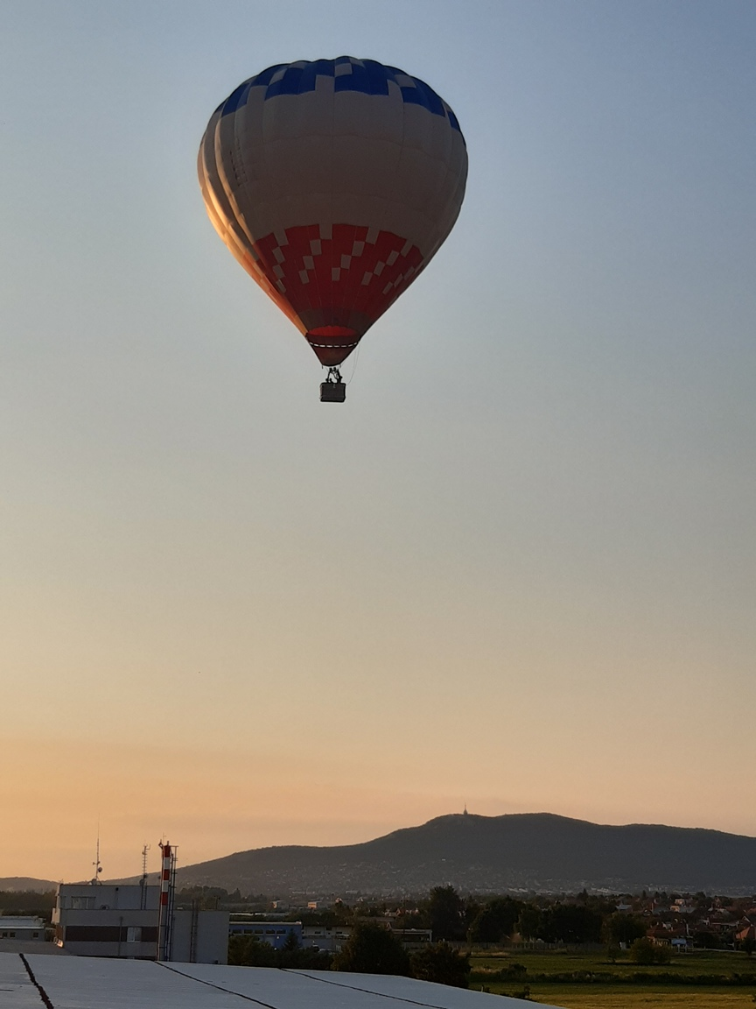
Ďakujem za pozornosť a prajem príjemný
let!

